Slide 1
Major Assignment
Group 3: Neron Parmar Jashanpreet Singh
Sanam Lakhotra Priyanka

Slide 2
Vision and Values
Amazon is guided by four principles: customer obsession rather than competitor focus, passion for invention, commitment to operational excellence, and long-term thinking.
Amazon strives to be Earth’s most customer-centric company, Earth’s best employer, and Earth’s safest place to work.
Customer reviews, 1-Click shopping, personalized recommendations, Prime, Fulfillment by Amazon, AWS, Kindle Direct Publishing, Kindle, Career Choice, Fire tablets, Fire TV, Amazon Echo, Alexa, Just Walk Out technology, Amazon Studios, and The Climate Pledge are some of the things pioneered by Amazon.

Slide 3

Product and services
Every day, we invent on behalf of our customers, partners, and communities.
Our vision is ambient intelligence, which uses artificial intelligence (AI) to weave together devices and services in a way that offers more value than any one product could on its own—at home or on the go.
Our customers inspire us, and they’ve been at the heart of how we invent and evolve our products.

Slide 4

CULTURE
Amazon's commitment to diversity, equity, and inclusion (DEI) is deeply embedded in its corporate culture and operations.
Guided by its 16 Leadership Principles, Amazon prioritizes diverse perspectives, learning, and trust-building.
Leaders actively create a safer, more diverse, and inclusive work environment while leading with empathy and fostering fun.
The company's vision is to be Earth's best employer and incorporates DEI into its efforts to build inclusive teams.
Amazon invests in communities, supports underrepresented entrepreneurs, and offers skills training.
It also emphasizes developing diverse leaders and mentorship programs to increase representation.
Affinity groups celebrate inclusivity, and the company actively promotes gender equity, supports Indigenous communities, and engages with the LGBTQIA+ community.
Amazon is dedicated to improving accessibility, supporting veterans and military families, and leveraging AI to accelerate progress.
These efforts have earned Amazon recognition and awards for its commitment to advancing DEI globally.

Slide 5


CLIENTS & IMPACTS
Clients:
Millions of individual customers worldwide.
Sellers and businesses using Amazon's platform.
AWS clients including startups and enterprises.
Impact:
Enabling small businesses to reach a global audience.
Shaping e-commerce and online services.
Environmental initiatives like The Climate Pledge.

Slide 6
REFERENCES:
Amazon Devices & Services (aboutamazon.com)

Slide 7

SUCCESS STORY OF AMAZON:
Amazon is founded by jeff Bezos as an online store in 1994 after quitting his job to focus on his initial idea.
Later in the late 1900s and early 2000s, growing to become a major internet retailer platform in North America and Europe.
gradually expanded its business Worldwide and the introduction of Amazon Web services expanded the scope of its services to include cloud computing, revolutionary online shopping.

Slide 8

SUCCESS STORY OF AMAZON: Key factors that contributed to Amazon's remarkable success include:
Amazon Web Services (AWS): The introduction of AWS allowed Amazon to provide cloud computing and services to various sectors globally, further diversifying its business.
Focus on Efficiency: Amazon's continuous efforts to improve its business operations and enhance efficiency contributed to its growth and success.
Commitment to Promises: Amazon's consistent delivery on its promises, from low prices to reliable shipping, built trust among customers.
Early Internet Adoption: Amazon capitalized on the power of the internet, establishing a strong online presence early on, which became a significant advantage.
Customer-Centric Approach: Amazon's focus on providing an exceptional customer experience, with features like simple and seamless interfaces, customization options, and fast shipping, helped build customer loyalty.
Innovation and Adaptability: Amazon's willingness to innovate, experiment with new ideas, and enhance the customer experience led to the introduction of services like Amazon Prime and technologies like Alexa.
Diverse Offerings: Starting as an online bookstore, Amazon expanded its product offerings to include DVDs, CDs, and a wide range of other products, catering to various markets and verticals.

Slide 9
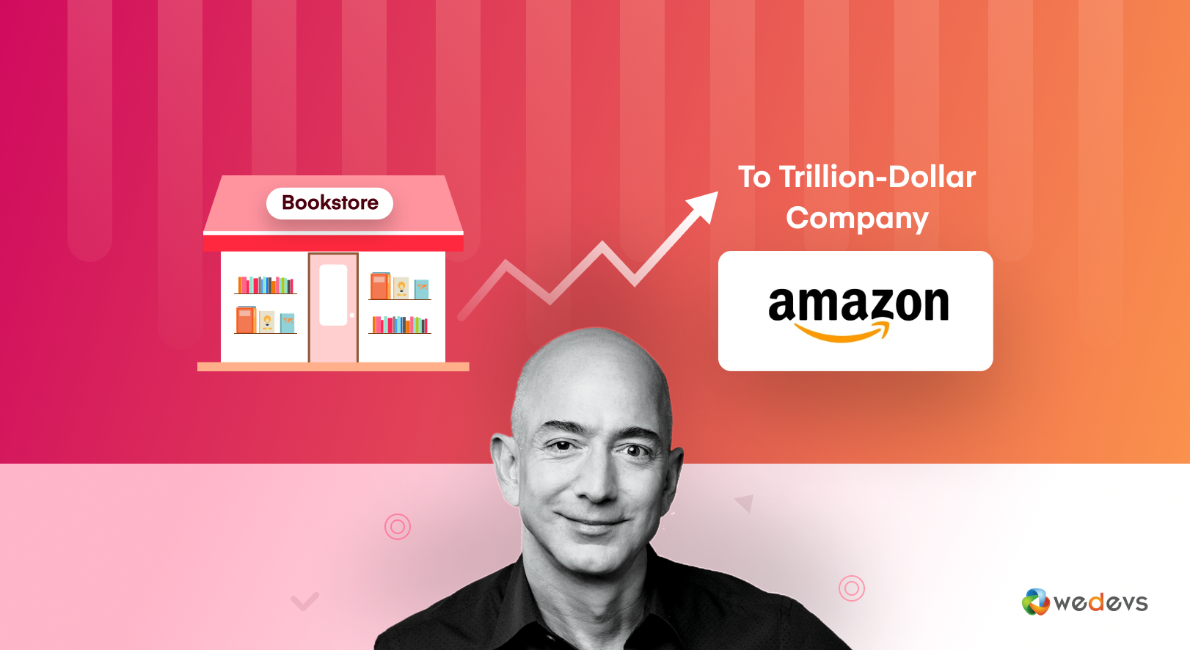
SUCCESS STORY OF AMAZON:
Amazon's journey to becoming a trillion-dollar eCommerce empire can be attributed to a strategic blend of customer-centric focus, a vast product range, cutting-edge technology, exceptional customer support, rapid delivery, innovative sales strategies, competitive pricing, global reach, consumer safety assurance, Kindle publishing, and a talented user experience (UX) team.
Reference:
https://wedevs.com/amp/blog/413420/amazon-success-story/

